Slide 1
Reactor Project with Spring Framework 5.0
Shazin Sadakath

Slide 2
Why Reactive?

Slide 3

Blocking Synchronous Programming

Slide 4
Blocking Synchronous Programming
Thread per Request (Swimming Pool)
Uses Blocking I/O
Thread waits burning CPU cycles until I/O responds
Connection contention
Scalability is limited to the maximum no of Threads

Slide 5
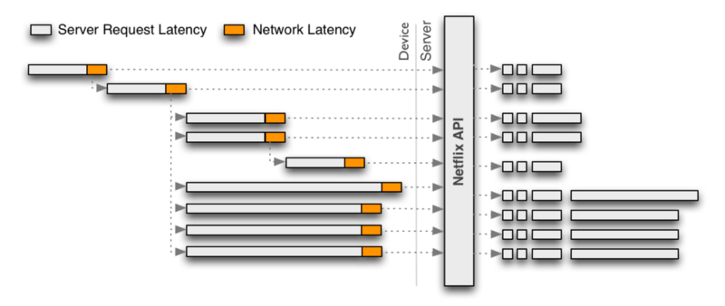
Problem of Blocking Synchronous Programming
Merging Multiple Requests

Slide 6
What is Reactive Programming?
Reactive programming is about writing non-blocking applications that are asynchronous and event-driven and require a small number of threads to scale up (i.e. within the JVM) instead of scale out (i.e. through clustering).

Slide 7




What is Reactive Programming?

Slide 8
What is Reactive Programming?

Slide 9
What is Reactive Programming?

Slide 10
What is Reactive Programming?

Slide 11

What is Reactive Programming?
Flow

Slide 12
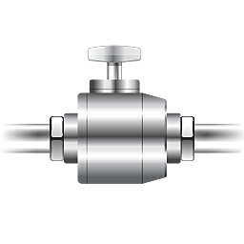
What is Reactive Programming?
Back pressure
Subscribe
Subscriber
Flow
Publisher

Slide 13

Reactive Programming (Non Blocking, Async.)

Slide 14
Reactive Programming (Non Blocking, Async.)
Event Loop (A Runway per CPU Core)
Uses Non Blocking I/O (Similar to select in C)
Uses Event Driven Architecture
Has Event Publishers and Subscribers
Has an Event Emitter Thread and Callbacks/Handlers attached to cater events.

Slide 15
Reactive Programming Summary
An alternative programming paradigm.
Simple, clean coding of asynchronous event driven application.
Declarative constructs for concise and error free code tailormade for high load and concurrency.
Accordance with Reactive Streams specification.

Slide 16
Reactor Project
Reactor Project is the Spring Framework’s default Reactive Programming Library.
It provides a set of programming constructs which can be used to develop reactive applications easily.
The main programming constructs under Reactor Project are:
Mono - Zero or One Event (0..1)
Flux - Zero or More Event (0..*)

Slide 17
Flux<T>
Basic Model
Flux emits events
Subscriber consumes events
Events can be messages, query results, computations, even errors
Flux
Subscriber
Stream of Events

Slide 18
Subscriber
Subscribes receives notifications on following:
onNext(T) - Recurring Notification
onCompletion() - Terminal Notification
onError() - Terminal Notification
Flux.subscribe method need to be used in order to subscribe for events.

Slide 19
Writing Reactive Application using Reactor Project
<dependency>
<groupId>io.projectreactor</groupId>
<artifactId>reactor-core</artifactId>
<version>${reactor-core.version}</version>
</dependency>

Slide 20
Writing Reactive Application using Reactor Project
Demo

Slide 21
Testing Reactive Applications using Reactor Project Test
<dependency>
<groupId>io.projectreactor</groupId>
<artifactId>reactor-test</artifactId>
<version>${reactor-core.version}</version>
<scope>test</scope>
</dependency>

Slide 22
Testing Reactive Applications using Reactor Project Test
Demo

Slide 23
Map vs FlatMap
Map
Transforms 1 source element into 1 output element
Does nothing particular other than the transformation from T to V
Transformation is “synchronous”
Returns a Flux<V>

Slide 24
Map vs FlatMap
FlatMap
Transforms 1 source element into a Flux of N elements
Subscribes to each generated Flux<V> then flattens their values
Transformation can be async
Returns a Flux<V>

Slide 25
Marble Diagrams for Visualizing
Marble Diagrams are used to Visualize the Reactive Constructs
Use the http://rxmarbles.com/

Slide 26
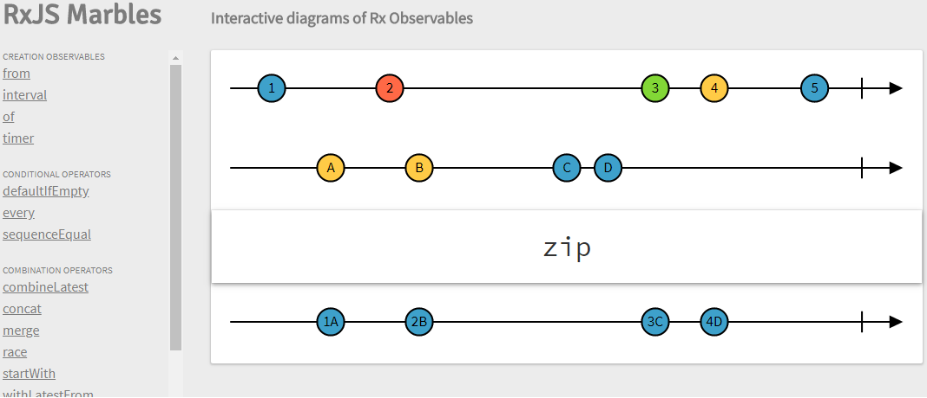
Marble Diagrams for Visualizing
Zip in Marble Diagram

Slide 27
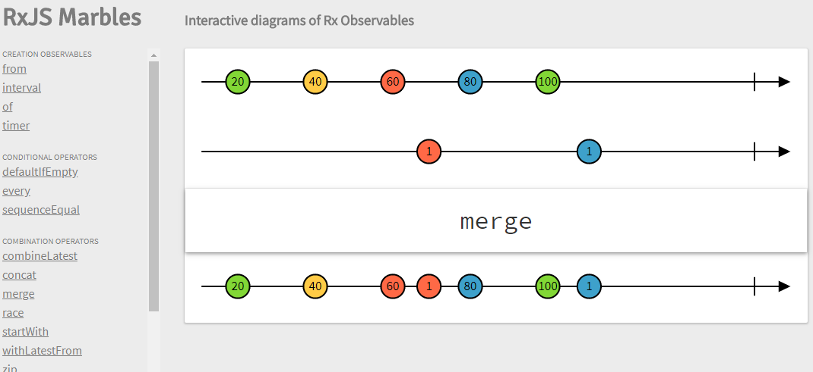
Marble Diagrams for Visualizing
Merge in Marble Diagram

Slide 28
Java Stream vs Reactor Project
Functional-style API to process a Collection or in-memory data once.
Pull based
Basically a way to iterate collections declaratively
Generally synchronous data
Streams can only be used once
No flow-control
No control of timing
No composition of streams
Finite amount of data

Slide 29
Java Stream vs Reactor Project
Functional-style API to process any sort of data (including asynchronously generated data), possibly multiple times.
Push based
Real-time data, latency, concurrency, flow control
Asynchronous-friendly
Reactive streams are highly reusable
Back-pressure strategies
Time-aware
Advanced composition/transformation
Data sizes from zero to infinity

Slide 30
Hot vs Cold Flux
Cold Flux
@Service
public class YoutubeService {
public Flux getPackets() {
return Flux.interval(Duration.ofSeconds(1)).map(s -> "Packet "+s);
}
}

Slide 31
Hot vs Cold Flux
Hot Flux
@Service
public class TelevisionService {
public ConnectableFlux getTransmission() {
return Flux.interval(Duration.ofSeconds(1)).map(s -> "Transmission "+s).publish();
}
}

Slide 32
Advantages of Reactor Project
Declarative, Functional Style of Programming
Scalable
Lazy execution
Fluent API
Increasing Community of Users, Developers

Slide 33
Summary
Reactor Project introduces Reactive Programming into Spring Framework
Supports 0..1 and 0..N data streaming
Contains functions transform, filter data
Enables focusing on What Needs to be done, not How
Not a Silver Bullet to solve all problems (Ex:- Can not work with JDBC)

Slide 34
Q&A

Slide 35
References
https://www.infoq.com/articles/Servlet-and-Reactive-Stacks-Spring-Framework-5
https://www.infoq.com/presentations/reactor-demo
http://www.reactive-streams.org/

